Slide 1
Image to Text Converter Web Application

Slide 2
Objective
This web is designed to extract any form of text or text-containing documents such as handwritten text, printed or scanned text images, and we can download extract text into text document.

Slide 3
Benefits
In business like Let’s look at one mock scenario. You need to renew a vehicle registration with your state government such as Name, Address, vehicle identification number, vehicle model, make and year.
Using OCR we can extract information from a written prescription can be sent over to a pharmacy via an app that might read the prescription using OCR, saving the patient and pharmacy time.

Slide 4
Data Sharing Agreement
Sample file name ('tumblr_pqe72dftcD1wv7k05_1280.png')
Length of date sample(2-6mb)

Slide 5
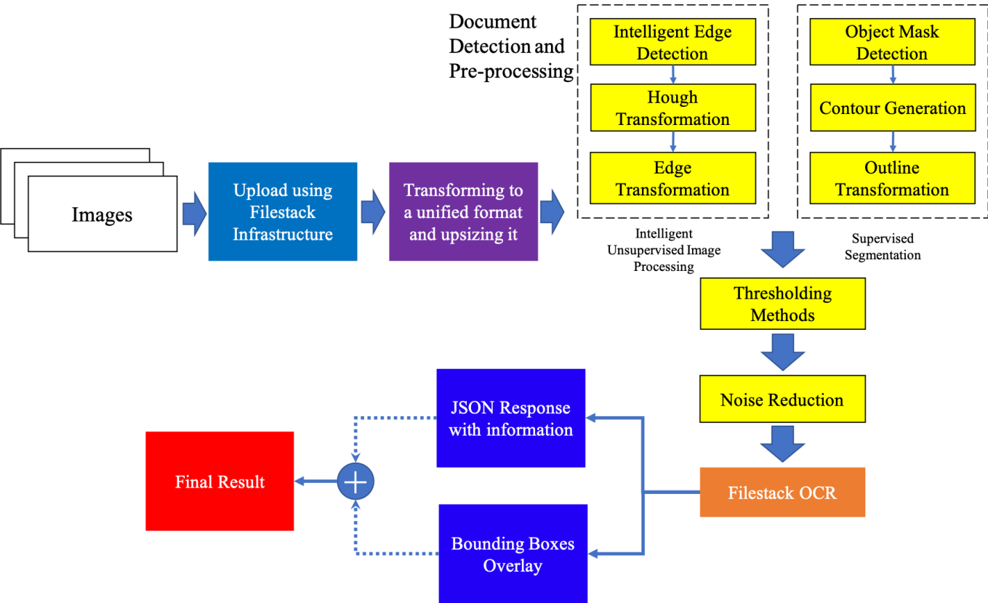
Architecture

Slide 6
Data Insertion in Database
Table creation : Table name “Hi" is created in the database for inserting the files. If the table is already present then new files are inserted in the same table.
Insertion of files in the table : User selected Image files will be inserted in the above-created table. If any file has invalid data type in any of the columns, the file is not loaded in the table

Slide 7
Q & A
Q 1) What was the type of data?
User can select any type of image types like(TIFF , GIF , PNG ,EPS )
Q 2) what you do with incompatible file or files?
If user has chosen other then any image type then program will give an
error saying that “please check selected file”
Q 3) How logs are managed?
We are using different logs as per the steps that we follow in validation
and modelling like File validation log , Data Insertion , etc.

Slide 8
Q4) What techniques were you using for data pre-processing?
Binarisation – Convert an image from color or grayscale to black-and-white
Line removal – Cleans up non-glyph boxes and lines.
Script recognition – In multilingual documents, the script may change at the level of the words and hence, identification of the script is necessary.
segmentation – For per-character OCR, multiple characters that are connected due to image artifacts must be separated.
Matrix matching: Involves comparing an image to a stored glyph on a pixel-by-pixel basis.
Feature extraction: The extraction features reduces the dimensionality of the representation and makes the recognition process computationally efficient.

Slide 9
Q5)what models and applications were used?
OpenCV (Open Source Computer Vision Library) is used, in order to extract text from image first we need to modify the given image.
Python-tesseract is an optical character recognition (OCR) tool is used to extract text from modify images.
Q 6) What are the deployment platforms?
we deployed in a GitHub and we have deployed in AWS and we have given a GitHub repository pipeline where we have uploaded project code.

